Slide 1
Md. Nuruzzaman, Ph.D. Director (Training), NAPD
PRODUCTION AND COST FUNCTIONS AND THEIR ESTIMATION

Slide 2
PRODUCTION FUNCTION
A table, graph, or equation showing the maximum output rate of the product that can be achieved from any specified set of usage rates of inputs

Slide 3
Introduction To Production Function Theory
Production function is the relation between input and output.
Production function is the name given to the relationship between the rates of input of productive services and the rate of output of a product.
Thus, the production function expresses the relationship between the quantity of output and the quantities of various inputs used for the production.

Slide 4
The Concept Of A Production Function
The production function is a mathematical expression which relates the quantity of factor inputs to the quantity of outputs that result. We make use of three measures of production / productivity.
Total product is simply the total output that is generated from the factors of production employed by a business. In most manufacturing industries such as motor vehicles, freezers and DVD players, it is straightforward to measure the volume of production from labor and capital inputs that are used. But in many service or knowledge-based industries, where much of the output is “intangible” or perhaps weightless we find it harder to measure productivity

Slide 5
The Concept Of A Production Function
Average product is the total output divided by the number of units of the variable factor of production employed (e.g. output per worker employed or output per unit of capital employed)
Marginal product is the change in total product when an additional unit of the variable factor of production is employed. For example marginal product would measure the change in output that comes from increasing the employment of labour by one person, or by adding one more machine to the production process in the short run.

Slide 6
Production Function

Slide 7
Production Function

Slide 8
Production Function

Slide 9
The Short Run Production Function
The short run is defined in economics as a period of time where at least one factor of production is assumed to be in fixed supply i.e. it cannot be changed.
We normally assume that the quantity of capital inputs (e.g. plant and machinery) is fixed and that production can be altered by suppliers through changing the demand for variable inputs such as labor, components, raw materials and energy inputs.
Often the amount of land available for production is also fixed.
The time periods used in textbook economics are somewhat arbitrary because they differ from industry to industry.

Slide 10
The Short Run Production Function
The short run for the electricity generation industry or the telecommunications sector varies from that appropriate for newspaper and magazine publishing and small-scale production of foodstuffs and beverages.
Much depends on the time scale that permits a business to alter all of the inputs that it can bring to production.
In the short run, the law of diminishing returns states that as we add more units of a variable input (i.e. labor or raw materials) to fixed amounts of land and capital, the change in total output will at first rise and then fall.
Diminishing returns to labor occurs when marginal product of labor starts to fall.

Slide 11
The Short Run Production Function
This means that total output will still be rising – but increasing at a decreasing rate as more workers are employed. As we shall see in the following numerical example, eventually a decline in marginal product leads to a fall in average product.
What happens to marginal product is linked directly to the productivity of each extra worker employed.
At low levels of labor input, the fixed factors of production - land and capital, tend to be under-utilized which means that each additional worker will have plenty of capital to use and, as a result, marginal product may rise.
Beyond a certain point however, the fixed factors of production become scarcer and new workers will not have as much capital to work with so that the capital input becomes diluted among a larger workforce.
As a result, the marginal productivity of each worker tends to fall – this is known as the principle of diminishing returns.

Slide 12
Law of Diminishing Marginal Returns
If equal increments of an input are added to a production process, and the quantities of other inputs are held constant, eventually the marginal product of the input will diminish
Note: 1) This is an empirical generalization.
2) Technology remains fixed.
3) The quantity of at least one input is
held fixed.

Slide 13
Law of Diminishing Marginal Returns
An example of the concept of diminishing returns is shown here. We assume that there is a fixed supply of capital (e.g. 20 units) available in the production process to which extra units of labor are added from one person through to eleven.
Initially the marginal product of labor is rising.
It peaks when the sixth worked is employed when the marginal product is 29.
Marginal product then starts to fall. Total output is still increasing as we add more labor, but at a slower rate. At this point the short run production demonstrates diminishing returns.
Average product will continue to rise as long as the marginal product is greater than the average – for example when the seventh worker is added the marginal gain in output is 26 and this drags the average up from 19 to 20 units.
Once marginal product is below the average as it is with the ninth worker employed (where marginal product is only 11) then the average will decline.

Slide 14
The Law of Diminishing Returns
Capital Input | Labor Input | Total Output | Marginal Product | Average Product of Labor
20 | 1 | 5 |  | 5
20 | 2 | 16 | 11 | 8
20 | 3 | 30 | 14 | 10
20 | 4 | 56 | 26 | 14
20 | 5 | 85 | 28 | 17
20 | 6 | 114 | 29 | 19
20 | 7 | 140 | 26 | 20
20 | 8 | 160 | 20 | 20
20 | 9 | 171 | 11 | 19
20 | 10 | 180 | 9 | 18
20 | 11 | 187 | 7 | 17

Slide 15
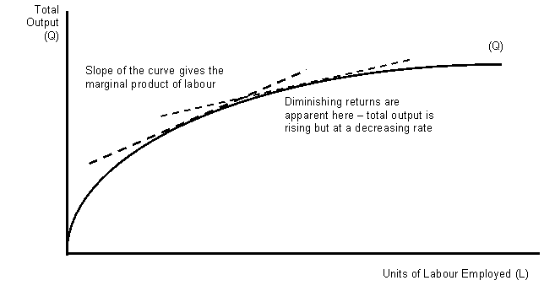

Slide 16
Criticisms of the Law of Diminishing Returns
How realistic is this notion of diminishing returns? Surely ambitious and successful businesses do what they can to avoid such a problem emerging.
It is now widely recognized that the effects of globalization, and in particular the ability of trans-national corporations to source their factor inputs from more than one country and engage in rapid transfers of business technology and other information, makes the concept of diminishing returns less relevant in the real world of business.
The expansion of “out-sourcing” as a means for a business to cut their costs and make their production processes as flexible as possible.
In many industries as a business expands, it is more likely to experience increasing returns. After all, why should a multinational business spend huge sums on expensive research and development and investment in capital machinery if a business cannot extract increasing returns and lower unit costs of production from these extra inputs?

Slide 17
Long Run Production - Returns To Scale
In the long run, all factors of production are variable. How the output of a business responds to a change in factor inputs is called returns to scale.
Increasing returns to scale occur when the % change in output > % change in inputs
Decreasing returns to scale occur when the % change in output < % change in inputs
Constant returns to scale occur when the % change in output = % change in inputs

Slide 18
A numerical example of long run returns to scale
Units of Capital | Units of Labor | Total Output | % Change in Inputs | % Change in Output | Returns to Scale
20 | 150 | 3000
40 | 300 | 7500 | 100 | 150 | Increasing
60 | 450 | 12000 | 50 | 60 | Increasing
80 | 600 | 16000 | 33 | 33 | Constant
100 | 750 | 18000 | 25 | 13 | Decreasing

Slide 19
Long Run Returns To Scale
In the example above, we increase the inputs of capital and labor by the same proportion each time. We then compare the % change in output that comes from a given % change in inputs.
In our example when we double the factor inputs from (150L + 20K) to (300L + 40K) then the percentage change in output is 150% - there are increasing returns to scale.
In contrast, when the scale of production is changed from (600L + 80K0 to (750L + 100K) then the percentage change in output (13%) is less than the change in inputs (25%) implying a situation of decreasing returns to scale.
As we shall see a later, the nature of the returns to scale affects the shape of a business’s long run average cost curve.

Slide 20
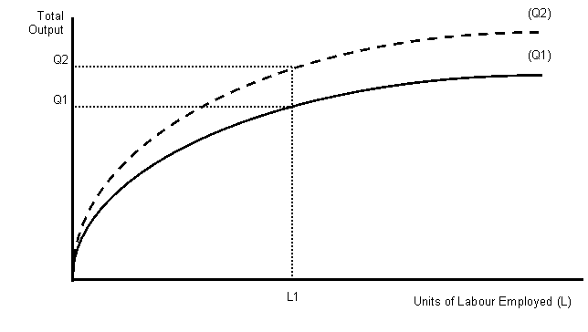
The Effect Of An Increase In Labor Productivity At all levels of employment productivity may have been increased through the effects of technological change; improved incentives; better management or the effects of work-related training which boosts the skills of the employed labor force

Slide 21
Two Aspects of Production Function Theory
The two aspects which are stressed under production function theory are
Maximum quantity of output can be produced from any chosen quantities of various inputs
Minimum quantities of various input that are required to yield a given quantity of output

Slide 22
Three Ways of Production Function Theory
The production function theory can be studied in three ways namely
(1) Law of variable proportion where quantities of some factors is kept fixed but the other factors are varied,
(2) Laws of Return to Scale where quantities of all factors is varied and
(3) Optimum combinations of inputs.
Production function can be algebraically expressed as
Q = f ( N , L , K , T )
where Q = quantity of output
N , L , K , T = quantités of inputs
f = unspecified form of functional relationship between N, L , K and T

Slide 23
Practical Importance of Production Function Theory
Production function gives an idea of the optimum level of the output and the optimum employment of the variable inputs.
It tells management the budget constraint for increase in output.
The production function theory explains the degree of substitution of different factors of production.
The management should endeavor to produce an upward shift in production function which can definitely improve its financial performance under the given market conditions.
The theory of production function can also explain the possibility of disguised unemployment.
As production function is an engineering concept, one can study the behavior of production function under different conditions.

Slide 24
The Analysis of Costs

Slide 25
Opportunity Costs
What Does Opportunity Cost Mean?
The cost of an alternative that must be forgone in order to pursue a certain action.
Put another way, the benefits you could have received by taking an alternative action.
The difference in return between a chosen investment and one that is necessarily passed up.
Say you invest in a stock and it returns a paltry 2% over the year. In placing your money in the stock, you gave up the opportunity of another investment - say, a risk-free government bond yielding 6%.
In this situation, your opportunity costs are 4% (6% - 2%).

Slide 26
Historical Costs
The amount the firm actually paid for a particular input

Slide 27
Explicit Vs. Implicit Costs
Explicit costs include the ordinary items that an accountant would include as the firms expenses
Implicit costs include opportunity costs of resources owned and used by the firm’s owner

Slide 28
Short Run
A period of time so short that the firm cannot alter the quantity of some of its inputs
Typically plant and equipment are fixed inputs in the short run
Fixed inputs determine the scale of the firm’s operation

Slide 29
Three Concepts Of Total Costs
Total fixed costs = FC
Total variable costs = VC
Total costs = FC + VC

Slide 30
Fixed, Variable And Total Costs

Slide 31
Fixed, Variable and Total Costs.

Slide 32
Average And Marginal Costs

Slide 33
Average And Marginal Costs

Slide 34
Long-run Cost Functions
Often considered to be the firm’s planning horizon
Describes alternative scales of operation when all inputs are variable
Average cost
Quantity of output

Slide 35
Long-run Average Cost Function
Shows the minimum cost per unit of producing each output level when any scale of operation is available
SR average cost functions
Average cost
LR average cost
Quantity of output

Slide 36
Key Steps: Cost Estimation Process
Definition of costs
Correction for price level changes
Relating cost to output
Matching time periods
Controlling product, technology, and plant
Length of period and sample size

Slide 37
Minimum Efficient Scale
The smallest output at which long-run average cost is a minimum.
Average cost
Quantity of output
Q_{mes}

Slide 38
The Survivor Technique
Classify the firms in an industry by size and compute the percentage of industry output coming from each size class at various times
If the share of one class diminishes over time, it is assumed to be inefficient
These firms are then operating below minimum efficient scale

Slide 39
Economies of Scope
Exist when the cost of producing two (or more) products jointly is less than the cost of producing each one alone.
S = C(Q₁) + C(Q₂) - C(Q₁+ Q₂)
C(Q₁+ Q₂)

Slide 40
Break-even Analysis
Total Revenue
Dollars
Total Cost
Profit
Loss
Quantity of output

